Slide 1
CONVOLUTION
Impulse Response Sequence of DT LTI Systems
Convolution Sum for DT LTI Systems
Properties of Convolution Sum
Impulse Response of LTI Systems
Convolution Integral for CT LTI Systems
Properties of Convolution Integral
Operational Definition of the Unit Impulse

Slide 2
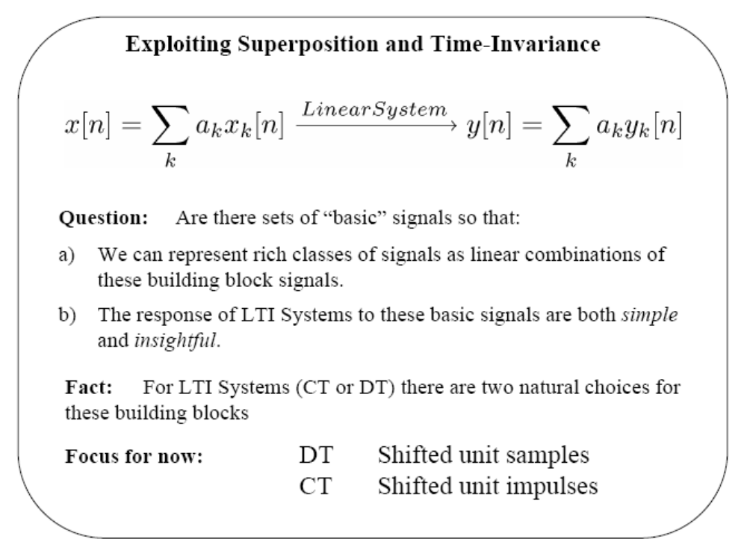

Slide 3
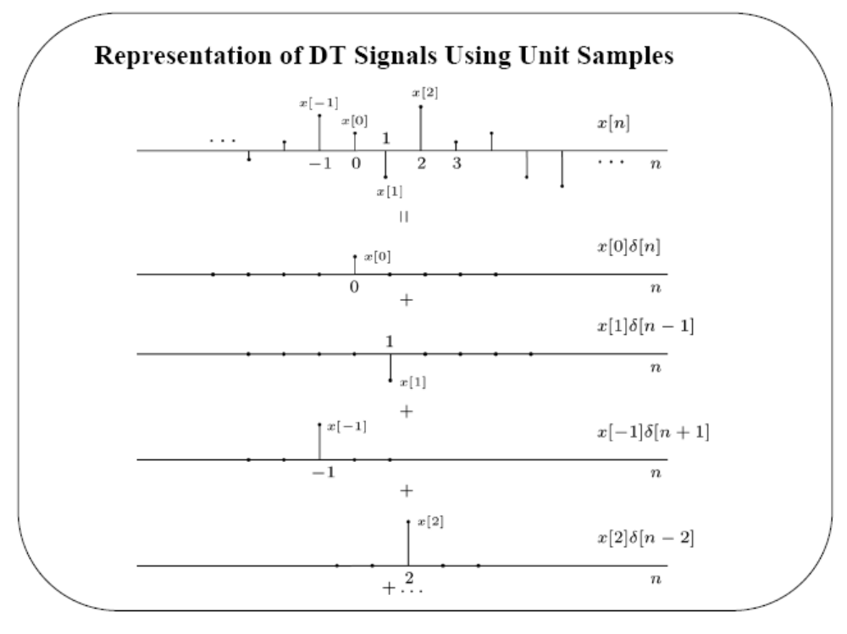

Slide 4
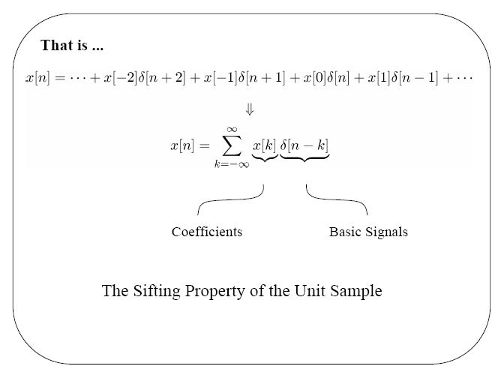

Slide 5
Impulse response of DT LTI systems:
Consider,
y(n) + a₁ y(n-1) + . . . + a_{n} y(n-k) = x(n) (1)
where x(n) is the impulse function δ(n), with δ(n) = 0 for n ≠ 0
and δ(n) = 0 for n < 0. Let h(n) be the impulse response sequence.
Since h(n) must satisfy the above equation for all n, we can write,
h(n) + a₁ h(n-1) + . . . + a_{n} h(n-k) = δ(n)
As all the terms on the left, except the first, will be zero for n=0,
this equation simplifies to
h(0) = 1
Notes:
h(n) + a1 h(n-1) + a2 h(n-2) + . . . + an h(n-k) = δ(n)

Slide 6
Similarly, for n = 1, all the terms except the first two are zero,
and we have
h(1) + a₁ h(0) = 0
Continuing with these steps yields k linear equations through which
initial conditions h(0), h(1), …, h(k-1) can be obtained.
Similar to the continuous case, we obtain the complementary
solution for the difference equation with δ(n) = 0 for n ≠ 0 and
calculate arbitrary constants to satisfy initial conditions.

Slide 7
Example: Consider
y(n) – 2 y(n-1) + 1.31 y(n-2) – 0.28 y(n-3) = x(n)
The characteristic equation (CE) is
Δ(q) = q³–2q²+1.31q–0.28 = 0 => q₁ = 0.5, q₂ = 0.7, q₃ = 0.8
Hence, the complementary solution is
y_{c}(n) = A (0.5)^{n} + B (0.7)^{n} + C (0.8)^{n}
To obtain i.c., we start with h(0)=1,
h(0) = 1 => h(0) = 1
h(1) – 2 h(0) = 0 => h(1) = 2
h(2) – 2 h(1) + 1.31 h(0) = 0 => h(2) = 2.69

Slide 8
Substituting these in the complementary solution gives,
A + B + C = 1 A=25/6
0.5 A + 0.7 B + 0.8 C = 2 => B=-49/2
0.25 A + 0.49 B + 0.64 C = 2.69 C=64/3
Hence, the impulse response sequence h(n) is obtained as
h(n) = (25/6) (0.5)^{n} – (49/2) (0.7)^{n} + (64/3) (0.8)^{n}
= 4.167 (0.5)^{n} – 24.5 (0.7)^{n} + 21.33 (0.8)^{n} n ≥ 0

Slide 9
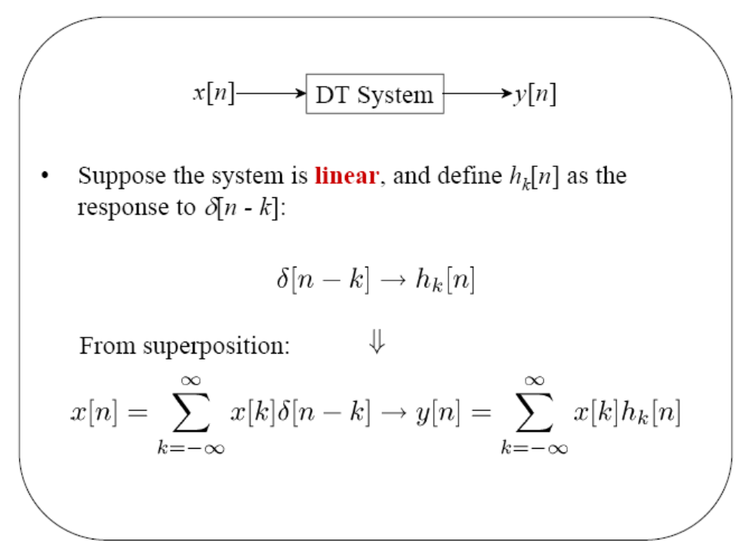

Slide 10
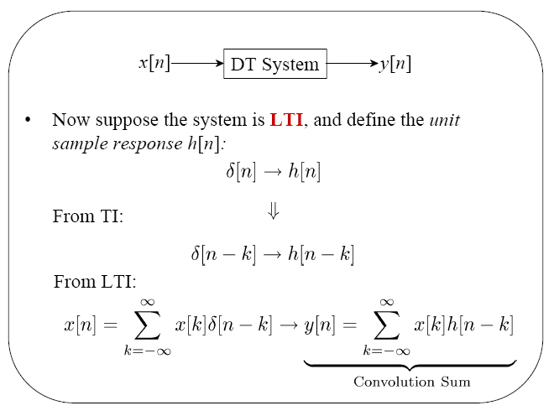

Slide 11
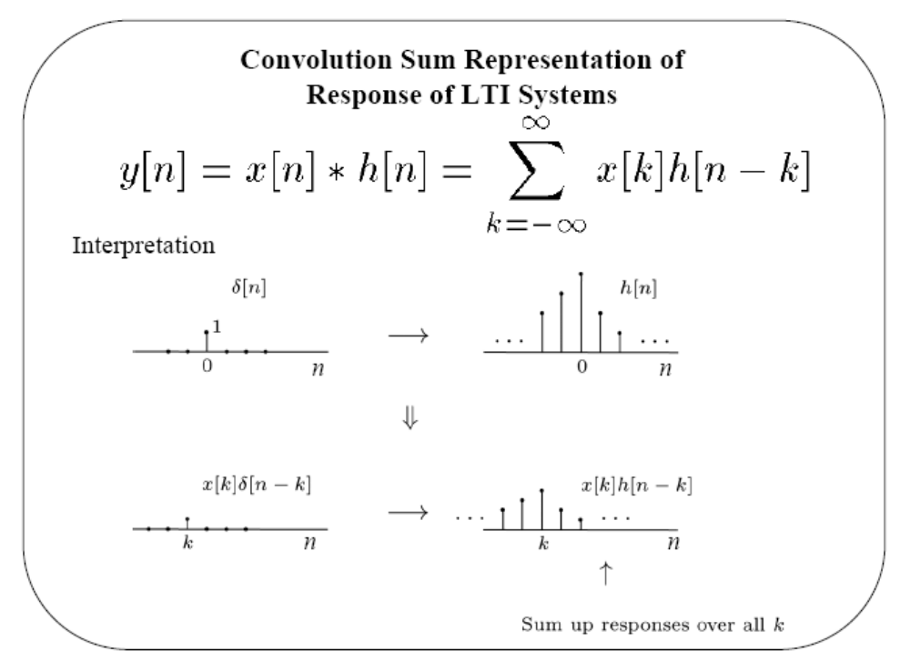

Slide 12
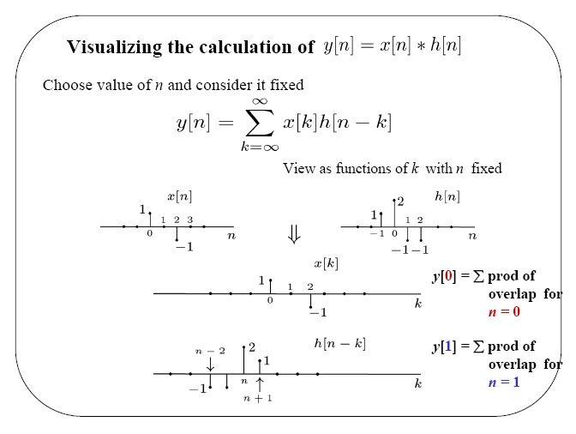

Slide 13
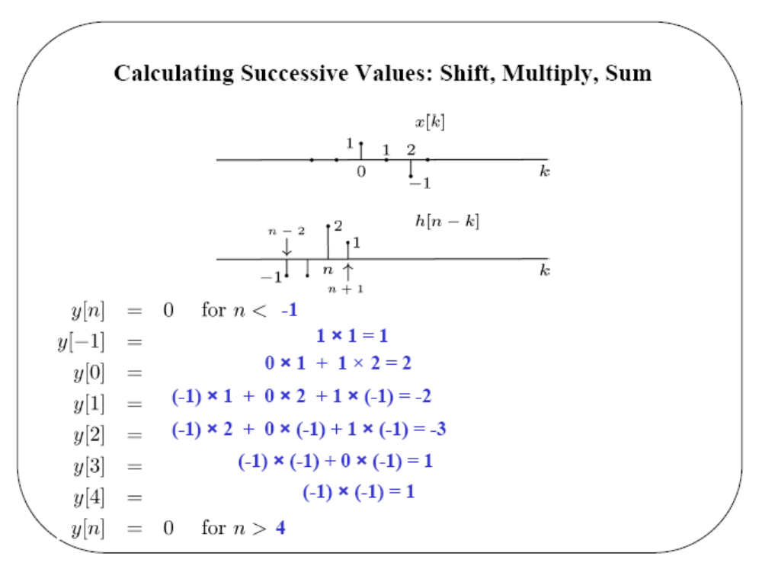

Slide 14
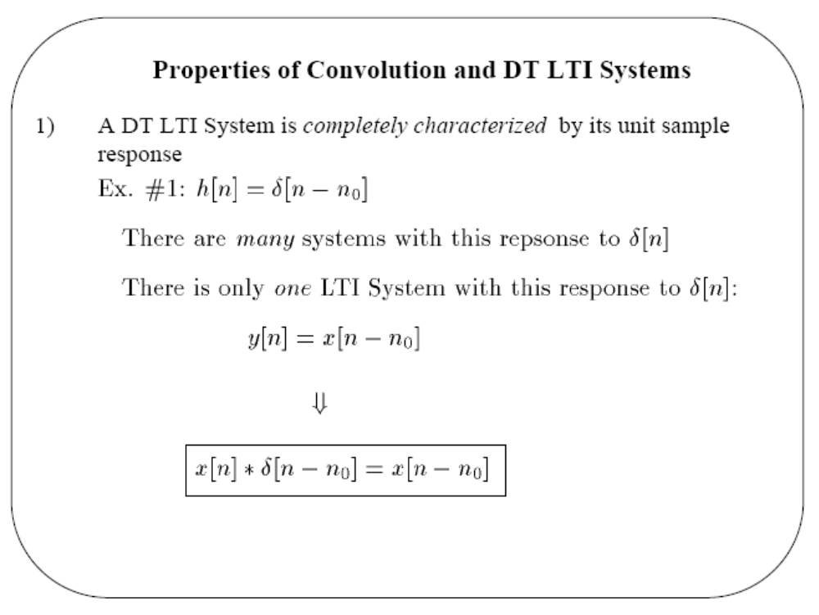

Slide 15
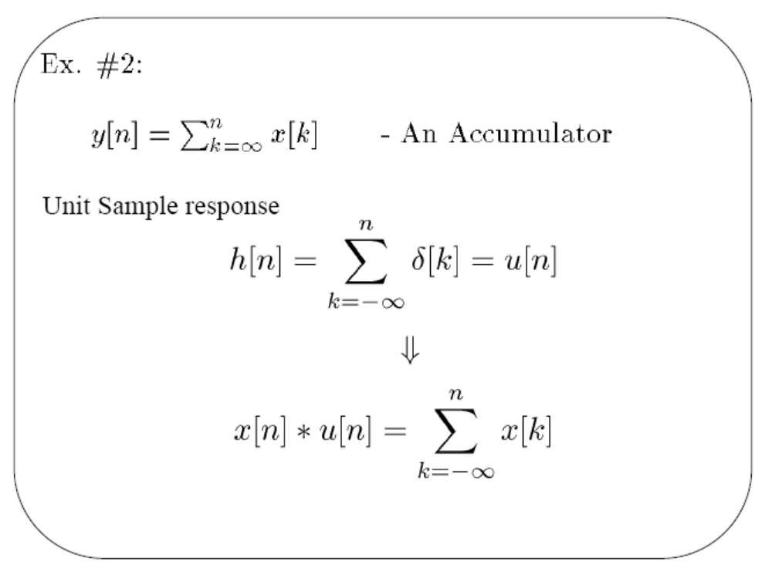

Slide 16

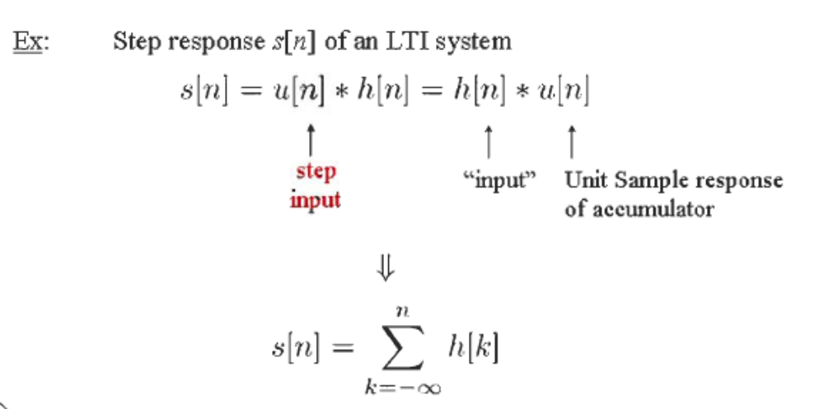
running sum
or h[n] = s[n] – s[n-1]

Slide 17
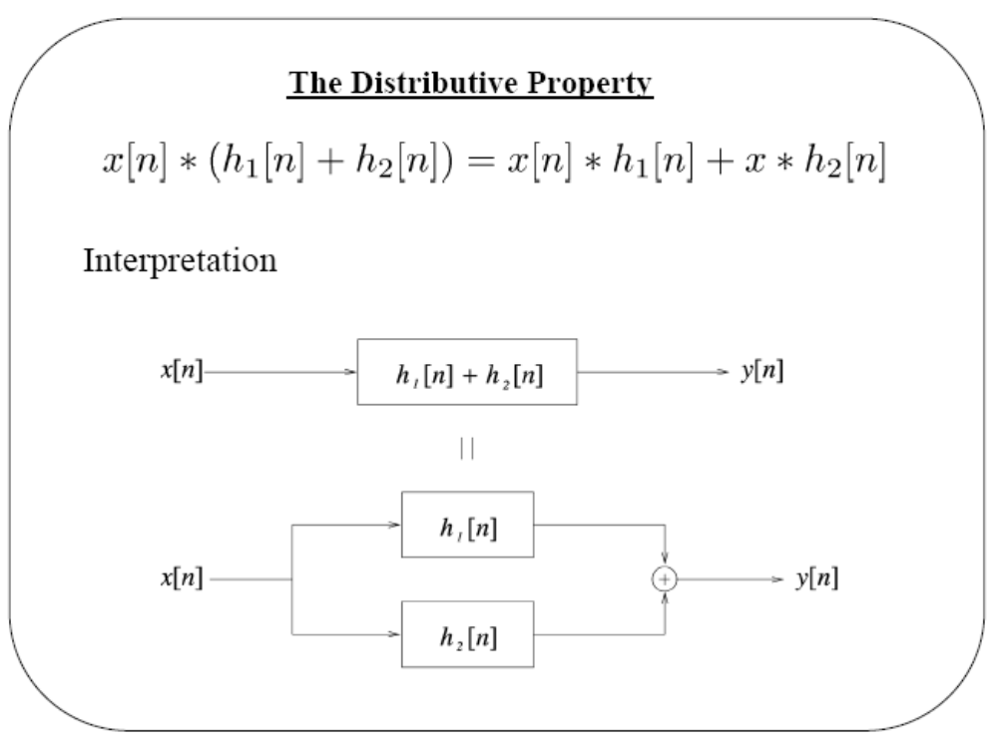

Slide 18
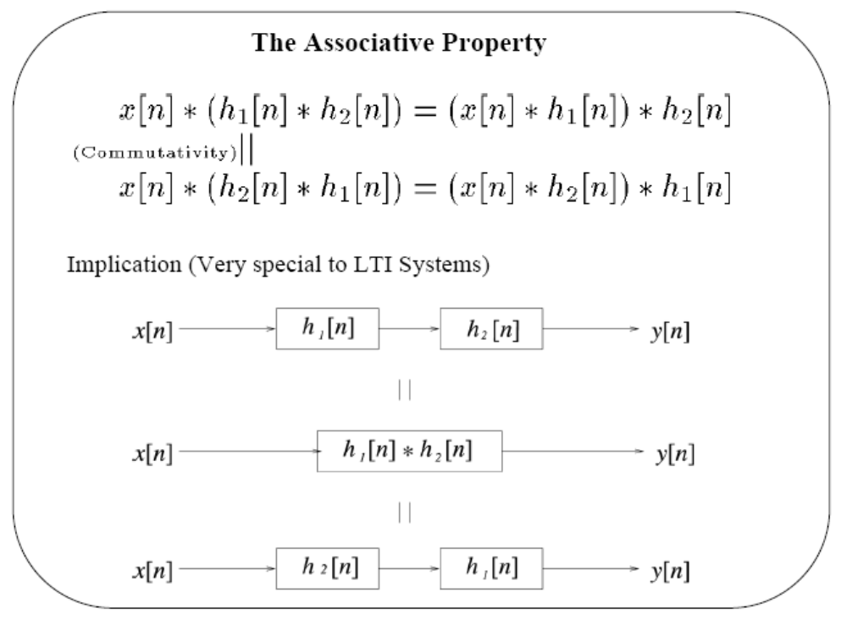

Slide 19
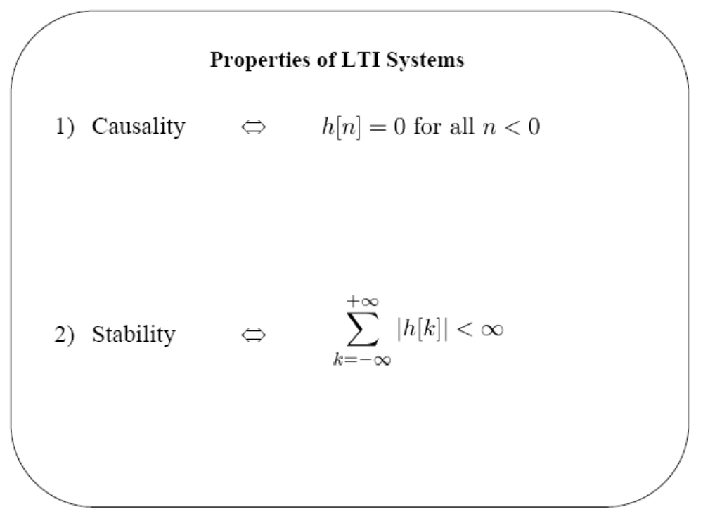

Slide 20
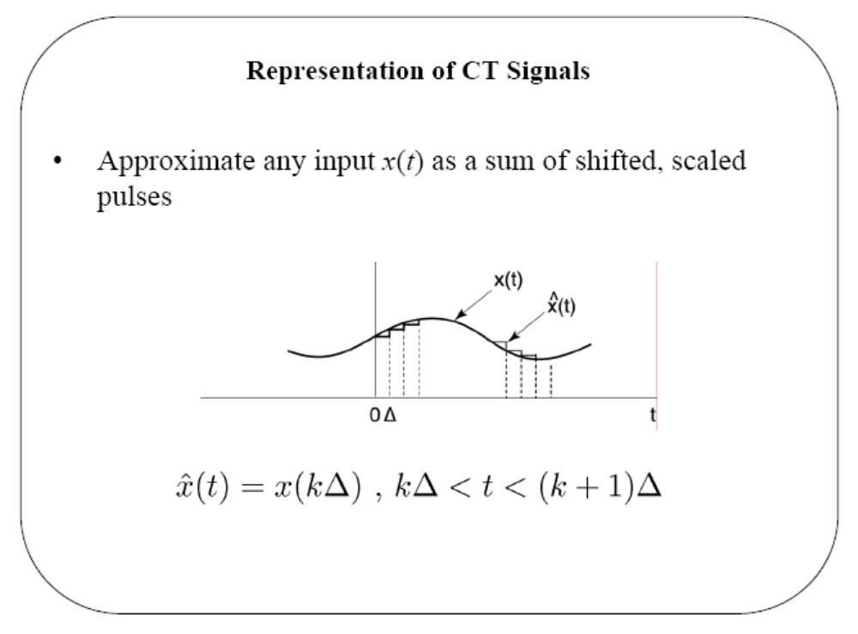

Slide 21
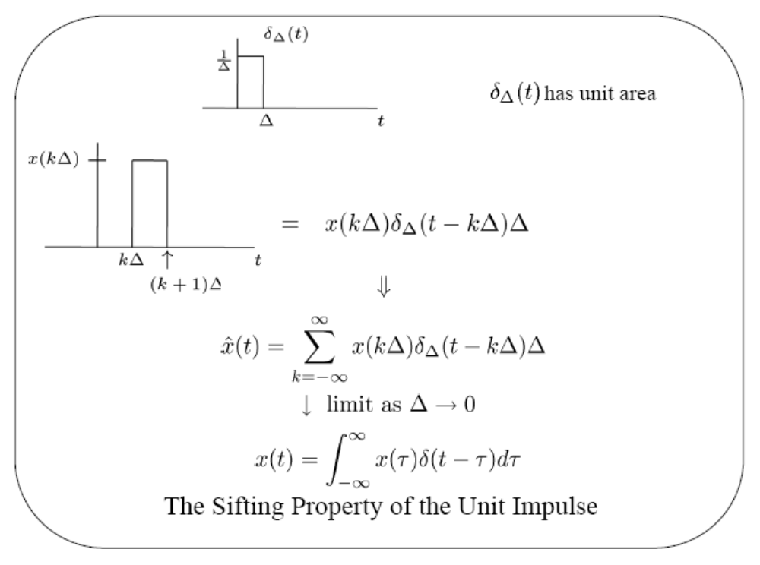
Δδ_{Δ}(t) has unit amplitude

Slide 22
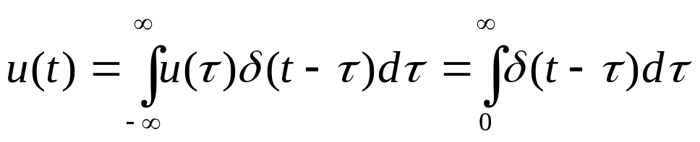
For the case of unit step signal, the above integral yields,
since u(τ)=0 for τ<0 and u(τ)=1 for τ>0.
Impulse response of CT LTI systems:
Consider a system described by the first-order differential equation,
y’(t) + a y(t) = x(t) (1)
where x(t)=δ(t) and assume that y=0 for t<0.

Slide 23
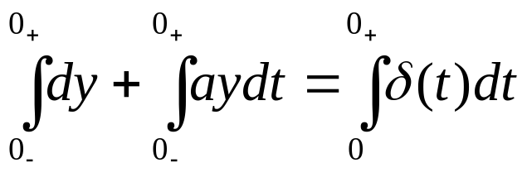
δ(t) is applied at t=0, so outside the interval 0₋ < t < 0₊
we have y=0 at t=0- and
y’(t) + a y(t) = 0 for t > 0₊
This homogeneous solution can be obtained easily, if y(0₊ ) is
known. Integrating (1) between t=0₋ and t=0₊ after multiplying
both sides by dt gives,
=> [y(0₊) – y(0₋)] + 0 = 1
where the second term is zero since y(t) is known to be finite, i.e. no discontinuities and (0₋, 0₊) is infinitesimal;
y(0₋)=0 => y(0₊)=1.

Slide 24
Therefore, the impulse response is given by
h(t) = e^{-at} u(t)
where u(t) is the step function. The response of a first order
linear system to a unit impulse is identical to the response of the
unforced system with the initial condition set to 1.
Similarly, the response of a unit impulse for the n-th order system
is identical to the response of the unforced system with
y^{(n-1)} (0₊)=1
and all the other initial conditions being zero.

Slide 25
Example: Consider,
y’’(t) + 4 y’(t) + 3 y(t) = x(t)
where y(0) = 0 and y’(0) = 1. The roots of the characteristic
polynomial are -1, -3, so we have the complementary function as
y_{c}(t) = A e^{-t} + B e^{-3t}
With i.c. we get
y_{c}(0) = A + B = 0
y’(0) = -A – 3B = 1 => A = 0.5, B = -0.5
Consequently, the impulse response h(t) is found as
h(t) = (0.5 e^{-t} -0.5 e^{-3t}) u(t)

Slide 26
Now consider the more general case with derivatives of x(t)
included,
D(p) y(t) = N(p) x(t)
where it is assumed that deg D(p) = n, deg N(p) ≤ (n-1), so that the
system function L(p) is strictly proper.
The system equation is considered in two parts as
D(p) z(t) = x(t)
y(t) = N(p) z(t)
such that the impulse response of the first equation is obtained and
afterwards used in the second equation.

Slide 27
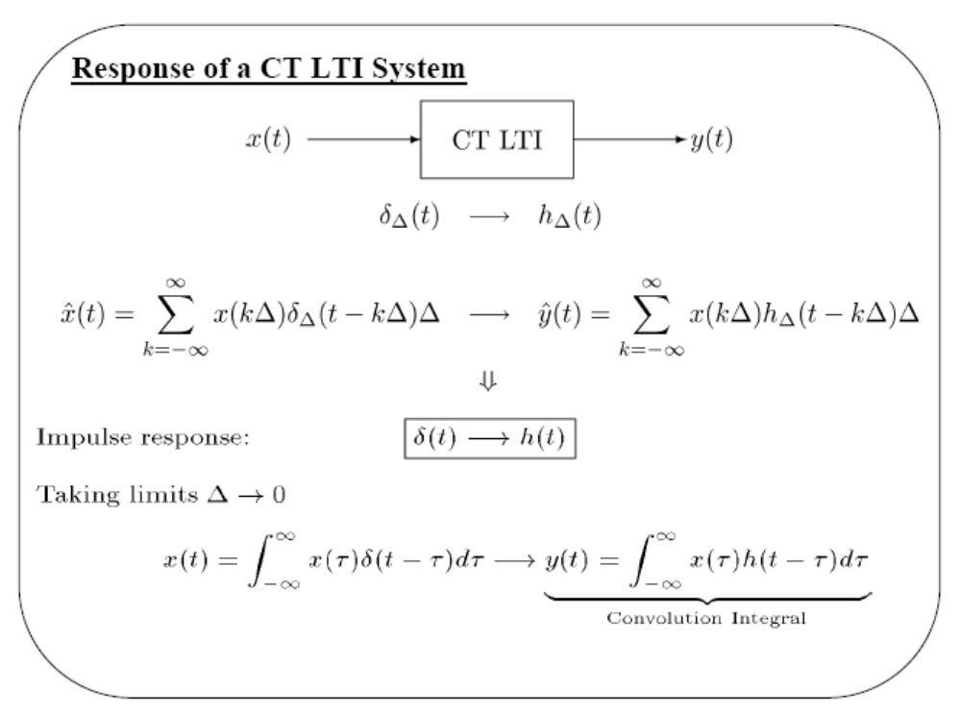

Slide 28
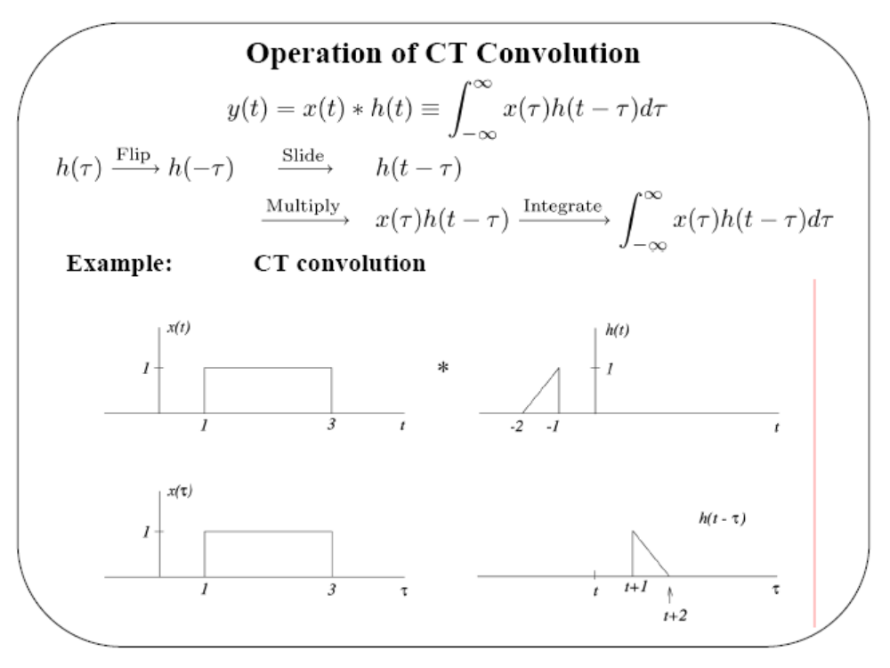

Slide 29
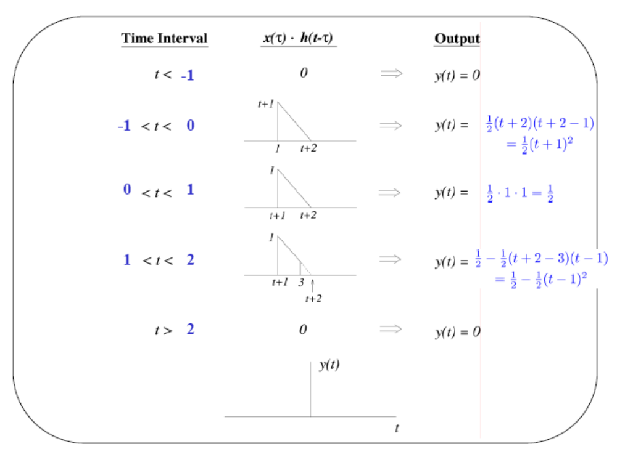

Slide 30
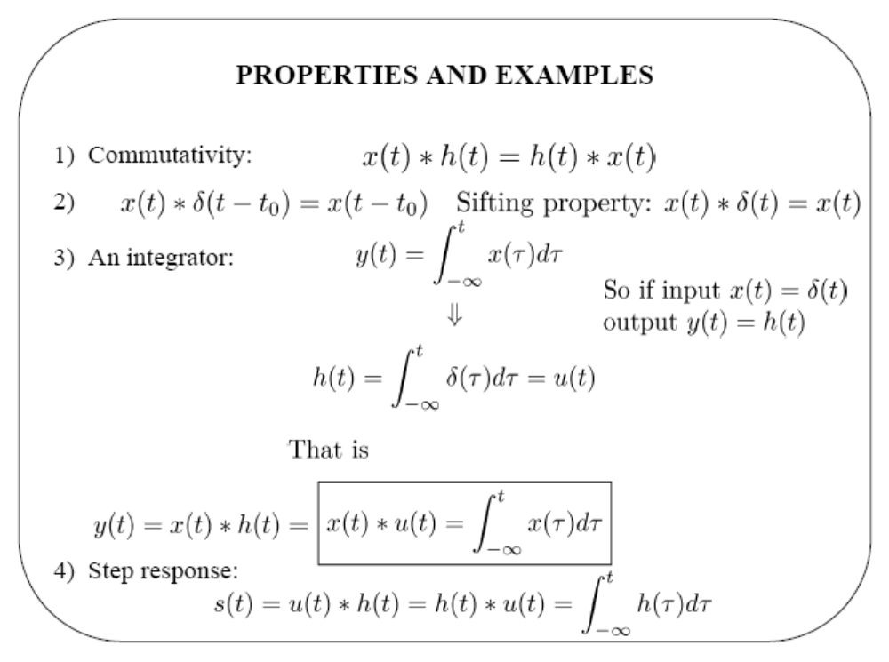
running
integral
or h(t)=ds/dt

Slide 31
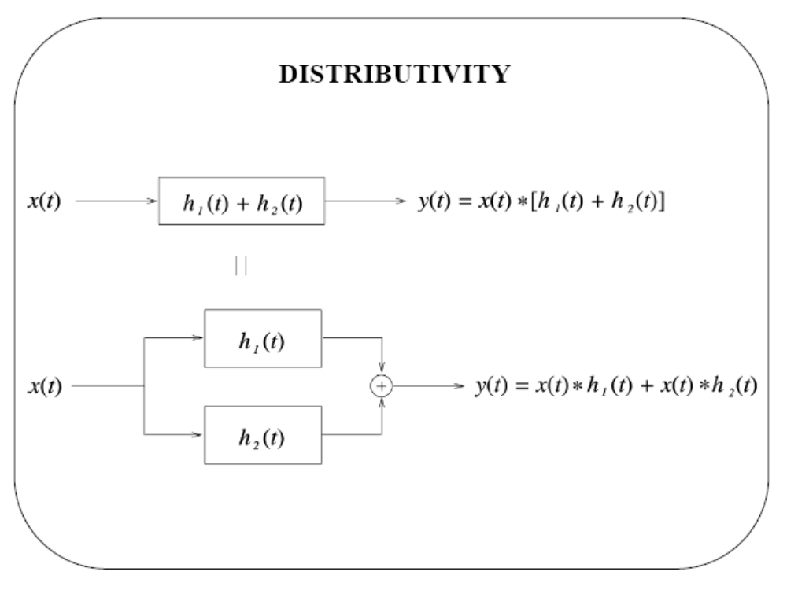

Slide 32
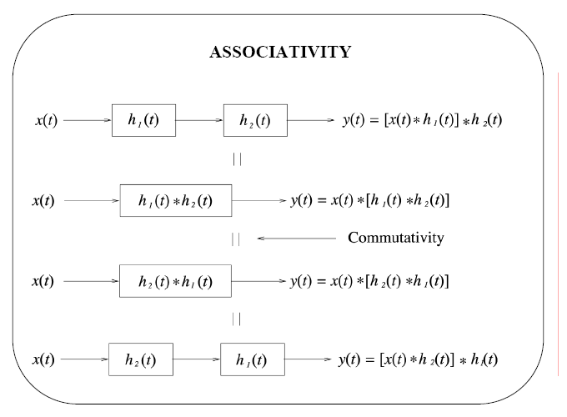

Slide 33
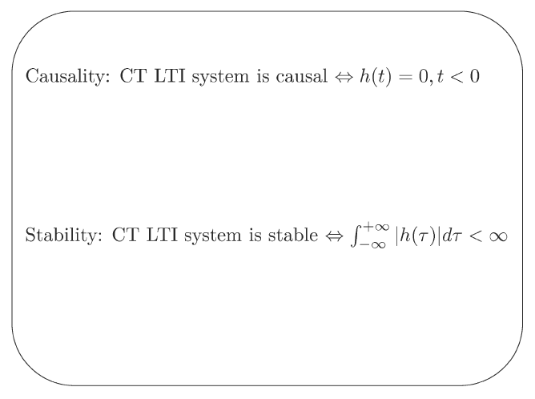

Slide 34
A DT LTI system is
memoryless if h(n) = 0 for n ≠ 0
and
with memory if h(n) ≠ 0 for n ≠ 0
A CT LTI system is
memoryless if h(t) = 0 for t ≠ 0
and
with memory if h(t) ≠ 0 for t ≠ 0
Examples for memoryless systems;
(a) h(n) = K δ(n), y(n) = K x(n) where K = h(0)
(b) h(t) = K δ(n), y(t) = K x(t)

Slide 35
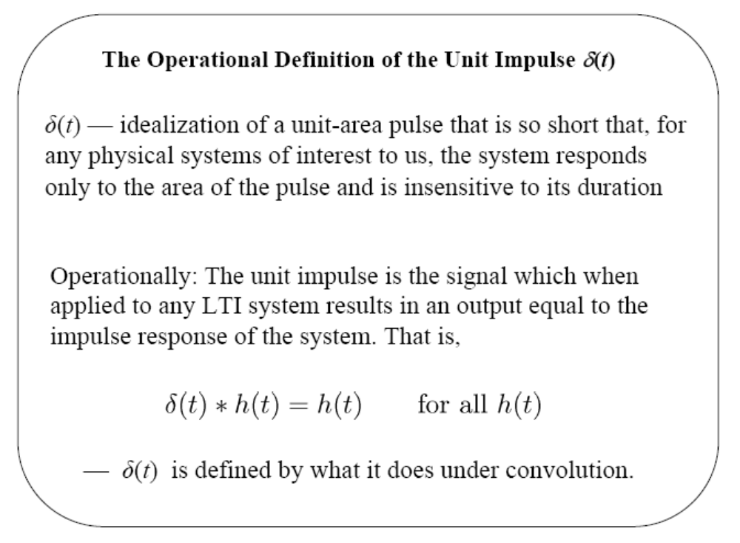

Slide 36
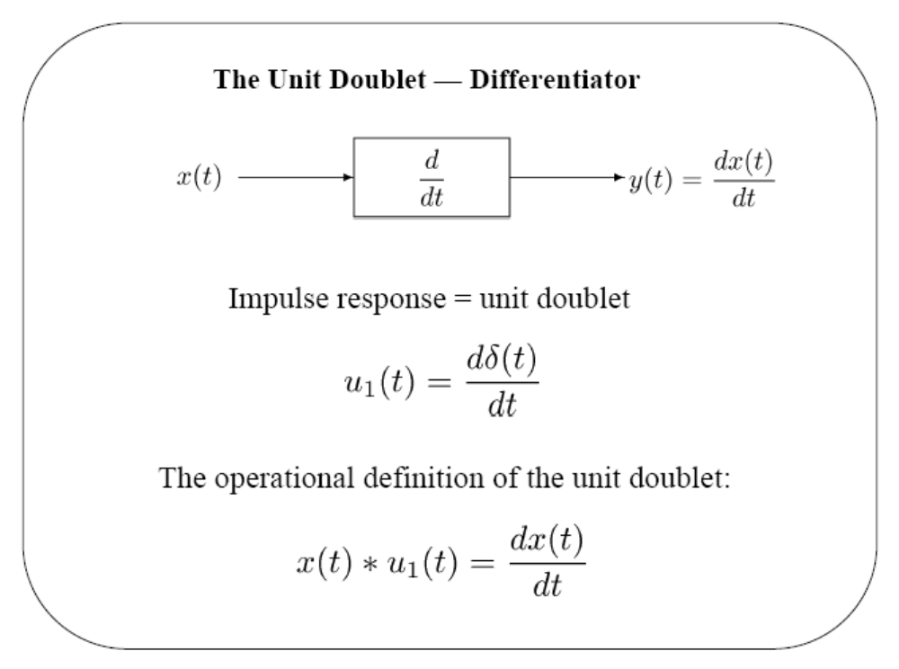

Slide 37
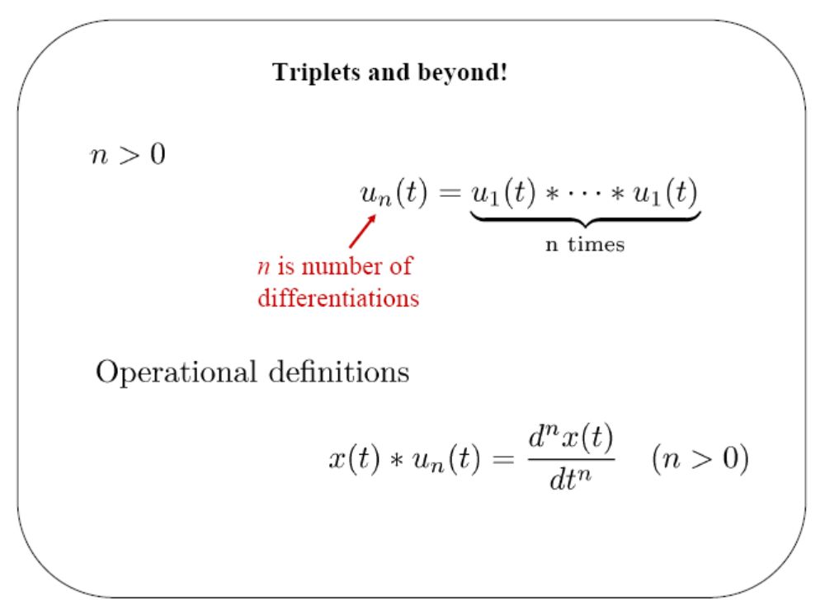

Slide 38
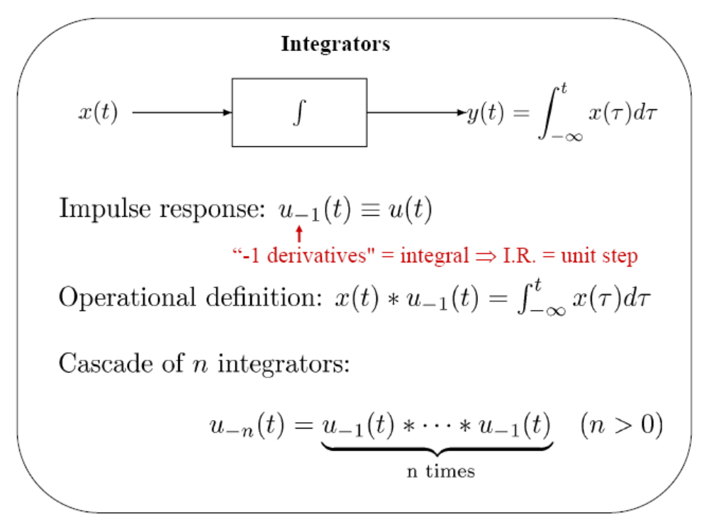

Slide 39
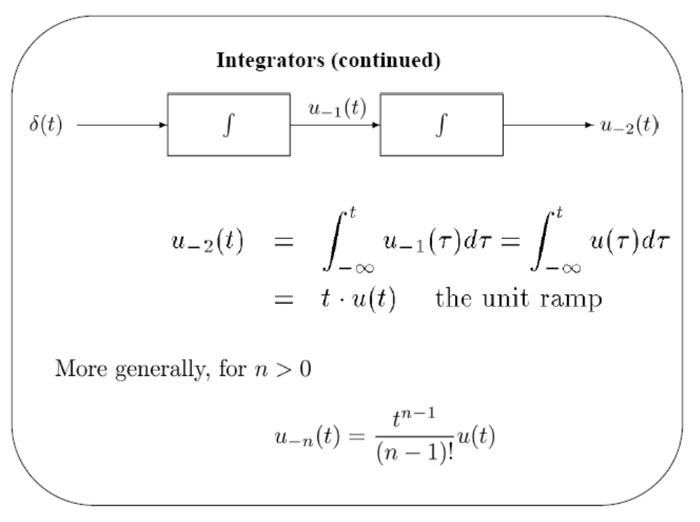

Slide 40
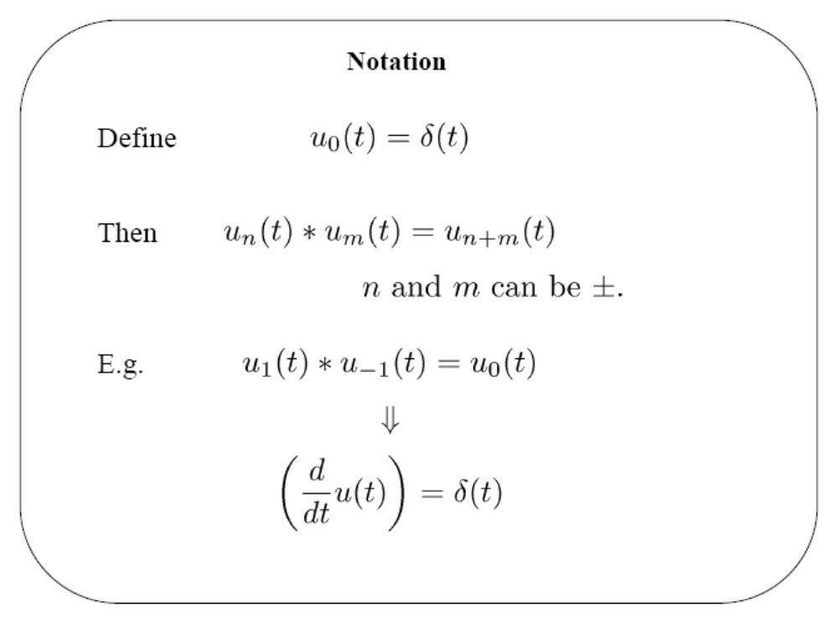

Slide 41
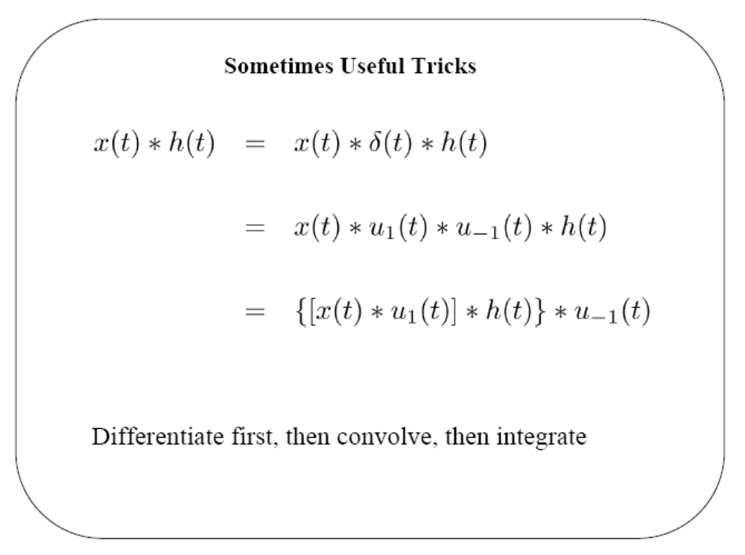

Slide 42
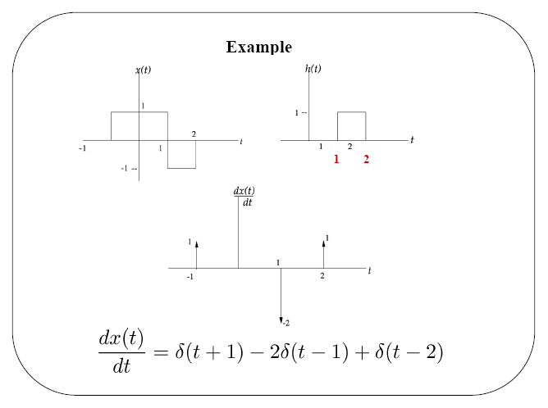

Slide 43
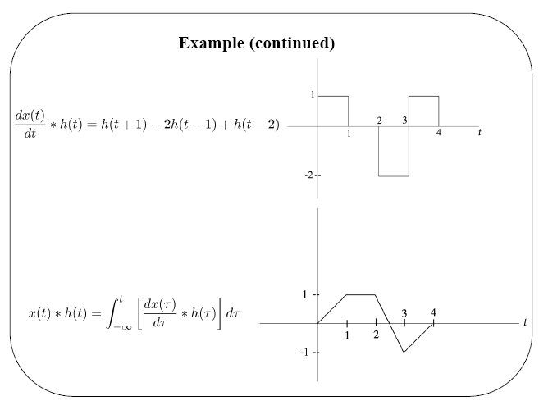

Slide 44
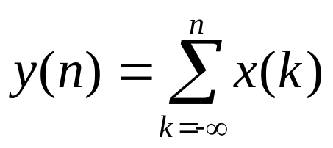
Inverse Systems
A system is said to be invertible if distinct inputs lead to distinct
outputs. If a system is invertible, then an inverse system exists
such that when cascaded with the original system yields an output
equal to the input to the first system.
y(t) = 2 x(t)
w(t) = (1/2)y(t)
x(t)
y(t)
w(t) = x(t)
system
inverse system
w(n)=y(n)-y(n-1)
x(n)
y(n)
w(n)=x(n)
1st order difference eq.
accumulator

Slide 45
In terms of impulse responses;
h(t)
h₁ (t)
x(t)
y(t)
w(t)=x(t)
inverse system
The overall impulse response is h(t) * h₁(t) where the condition that h₁(t) must satisfy for it to be the impulse response of the inverse system is,
h(t) * h₁(t) = δ(t)
identity system
δ(t)
=>
x(t)
x(t)
Similar results for DT case: h(n) * h₁(n) = δ(n)

